Slide 1
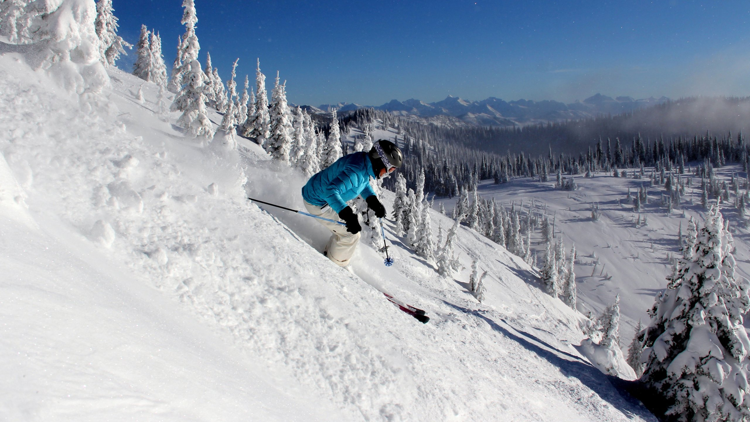
Big mountain resort Price analysis report
Presented by: Prakash Parajuli

Slide 2


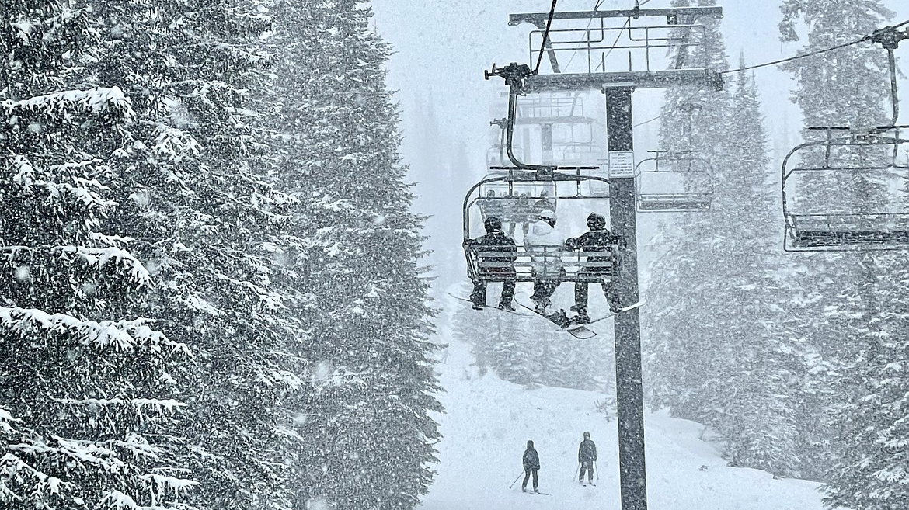






Problem Statement:
Increased Operating Costs: $1.54 million due to recent chairlift addition.
Underutilized Premium Pricing: Does not maximize features like National Park views, 105 trails, and 350,000 annual visitors.
Objective:
Develop Data-Driven Pricing Model: Reflect facility value accurately.
Explore Revenue Optimization: Cost-saving measures and premium pricing strategies.

Slide 3
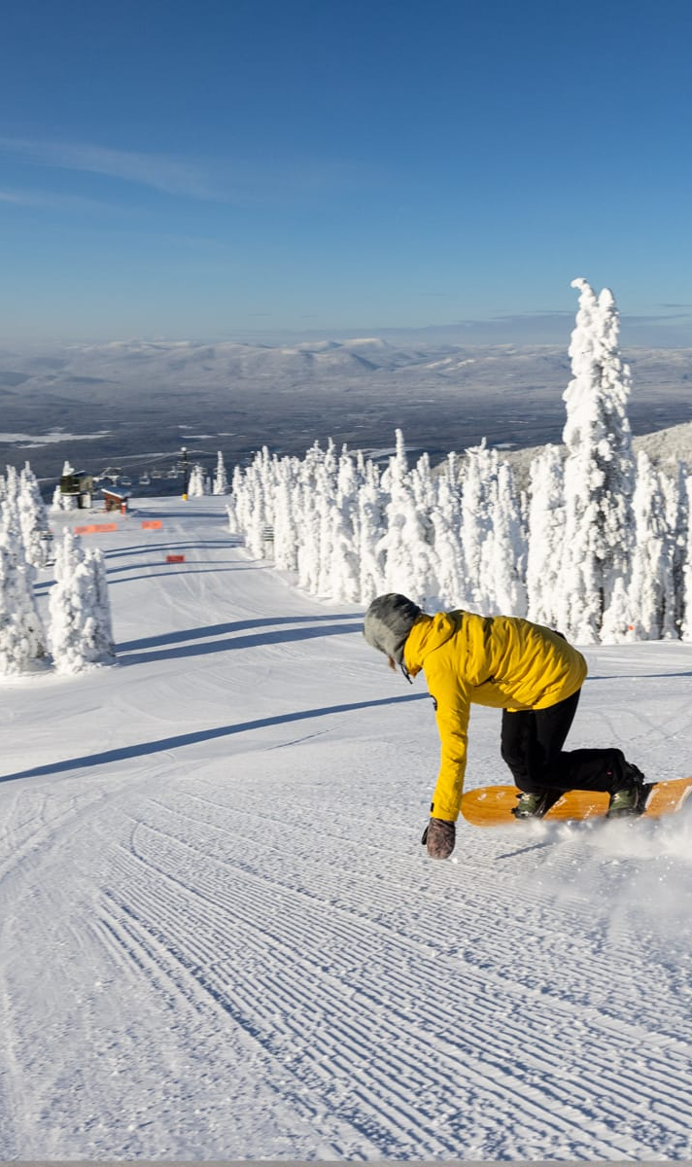
Recommendation and key findings
Increase
Consider
Remove
Increase ticket prices gradually to $95.87 from $81.00
Current pricing of $81 is based on premium-above-average pricing approach and doesn’t consider its competitiveness with respect to its national standing.
Consider expanding the vertical drop by 150 foot
Will support a further increase in ticket price by $2.0. This will potentially add $3.47 million revenue.
Remove underutilized runs not more than 5.
Big Mountain ranks second among Montana resorts and nineteenth nationally in run count and closing few run has negligible to small impact in ticket price.

Slide 4
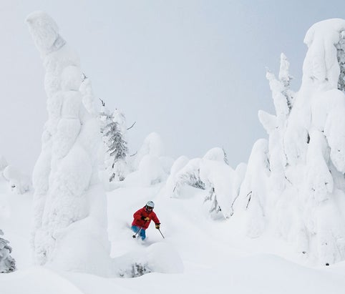
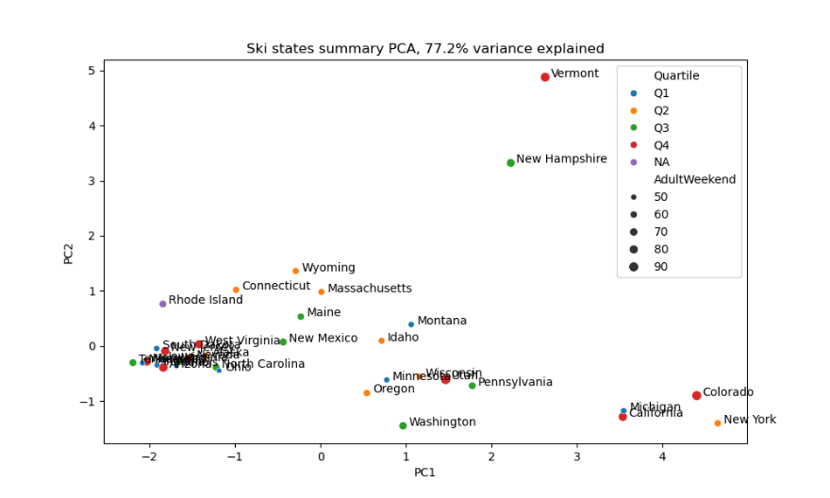
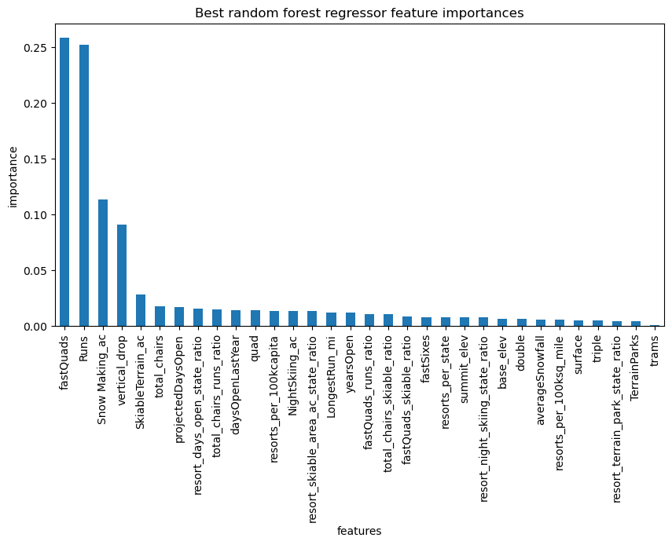
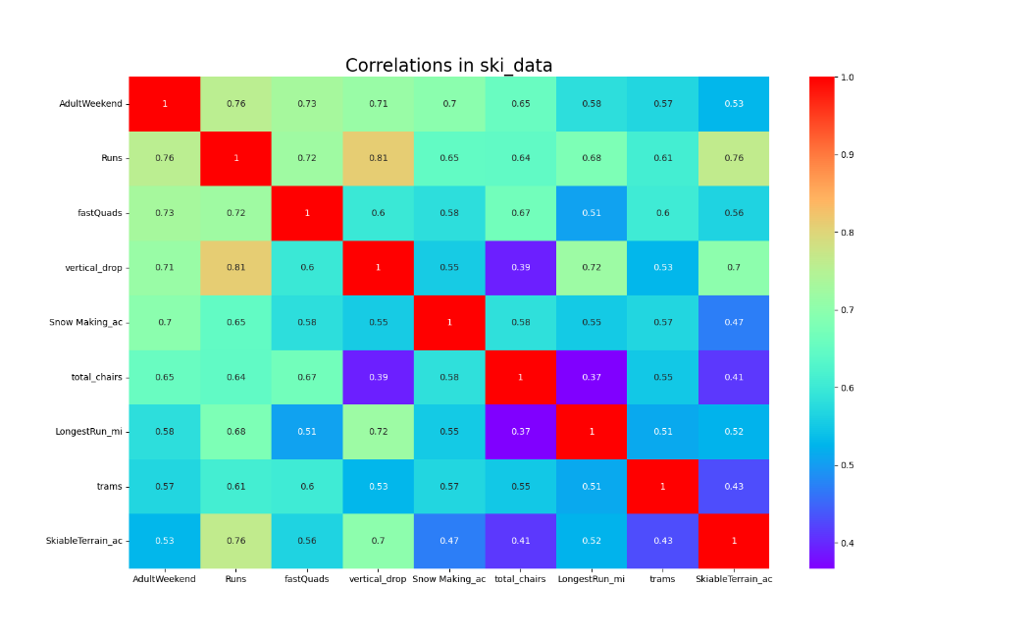
Modeling results and analysis
Principal Component Analysis (PCA)
Heatmap and Feature Importances
no discernible pattern or clustering of states within different ticket price quartiles.
Features such as 'Runs', 'fastQuads', 'vertical_drop', and 'Snow Making_ac' exhibited strong correlations with ticket prices.

Slide 5
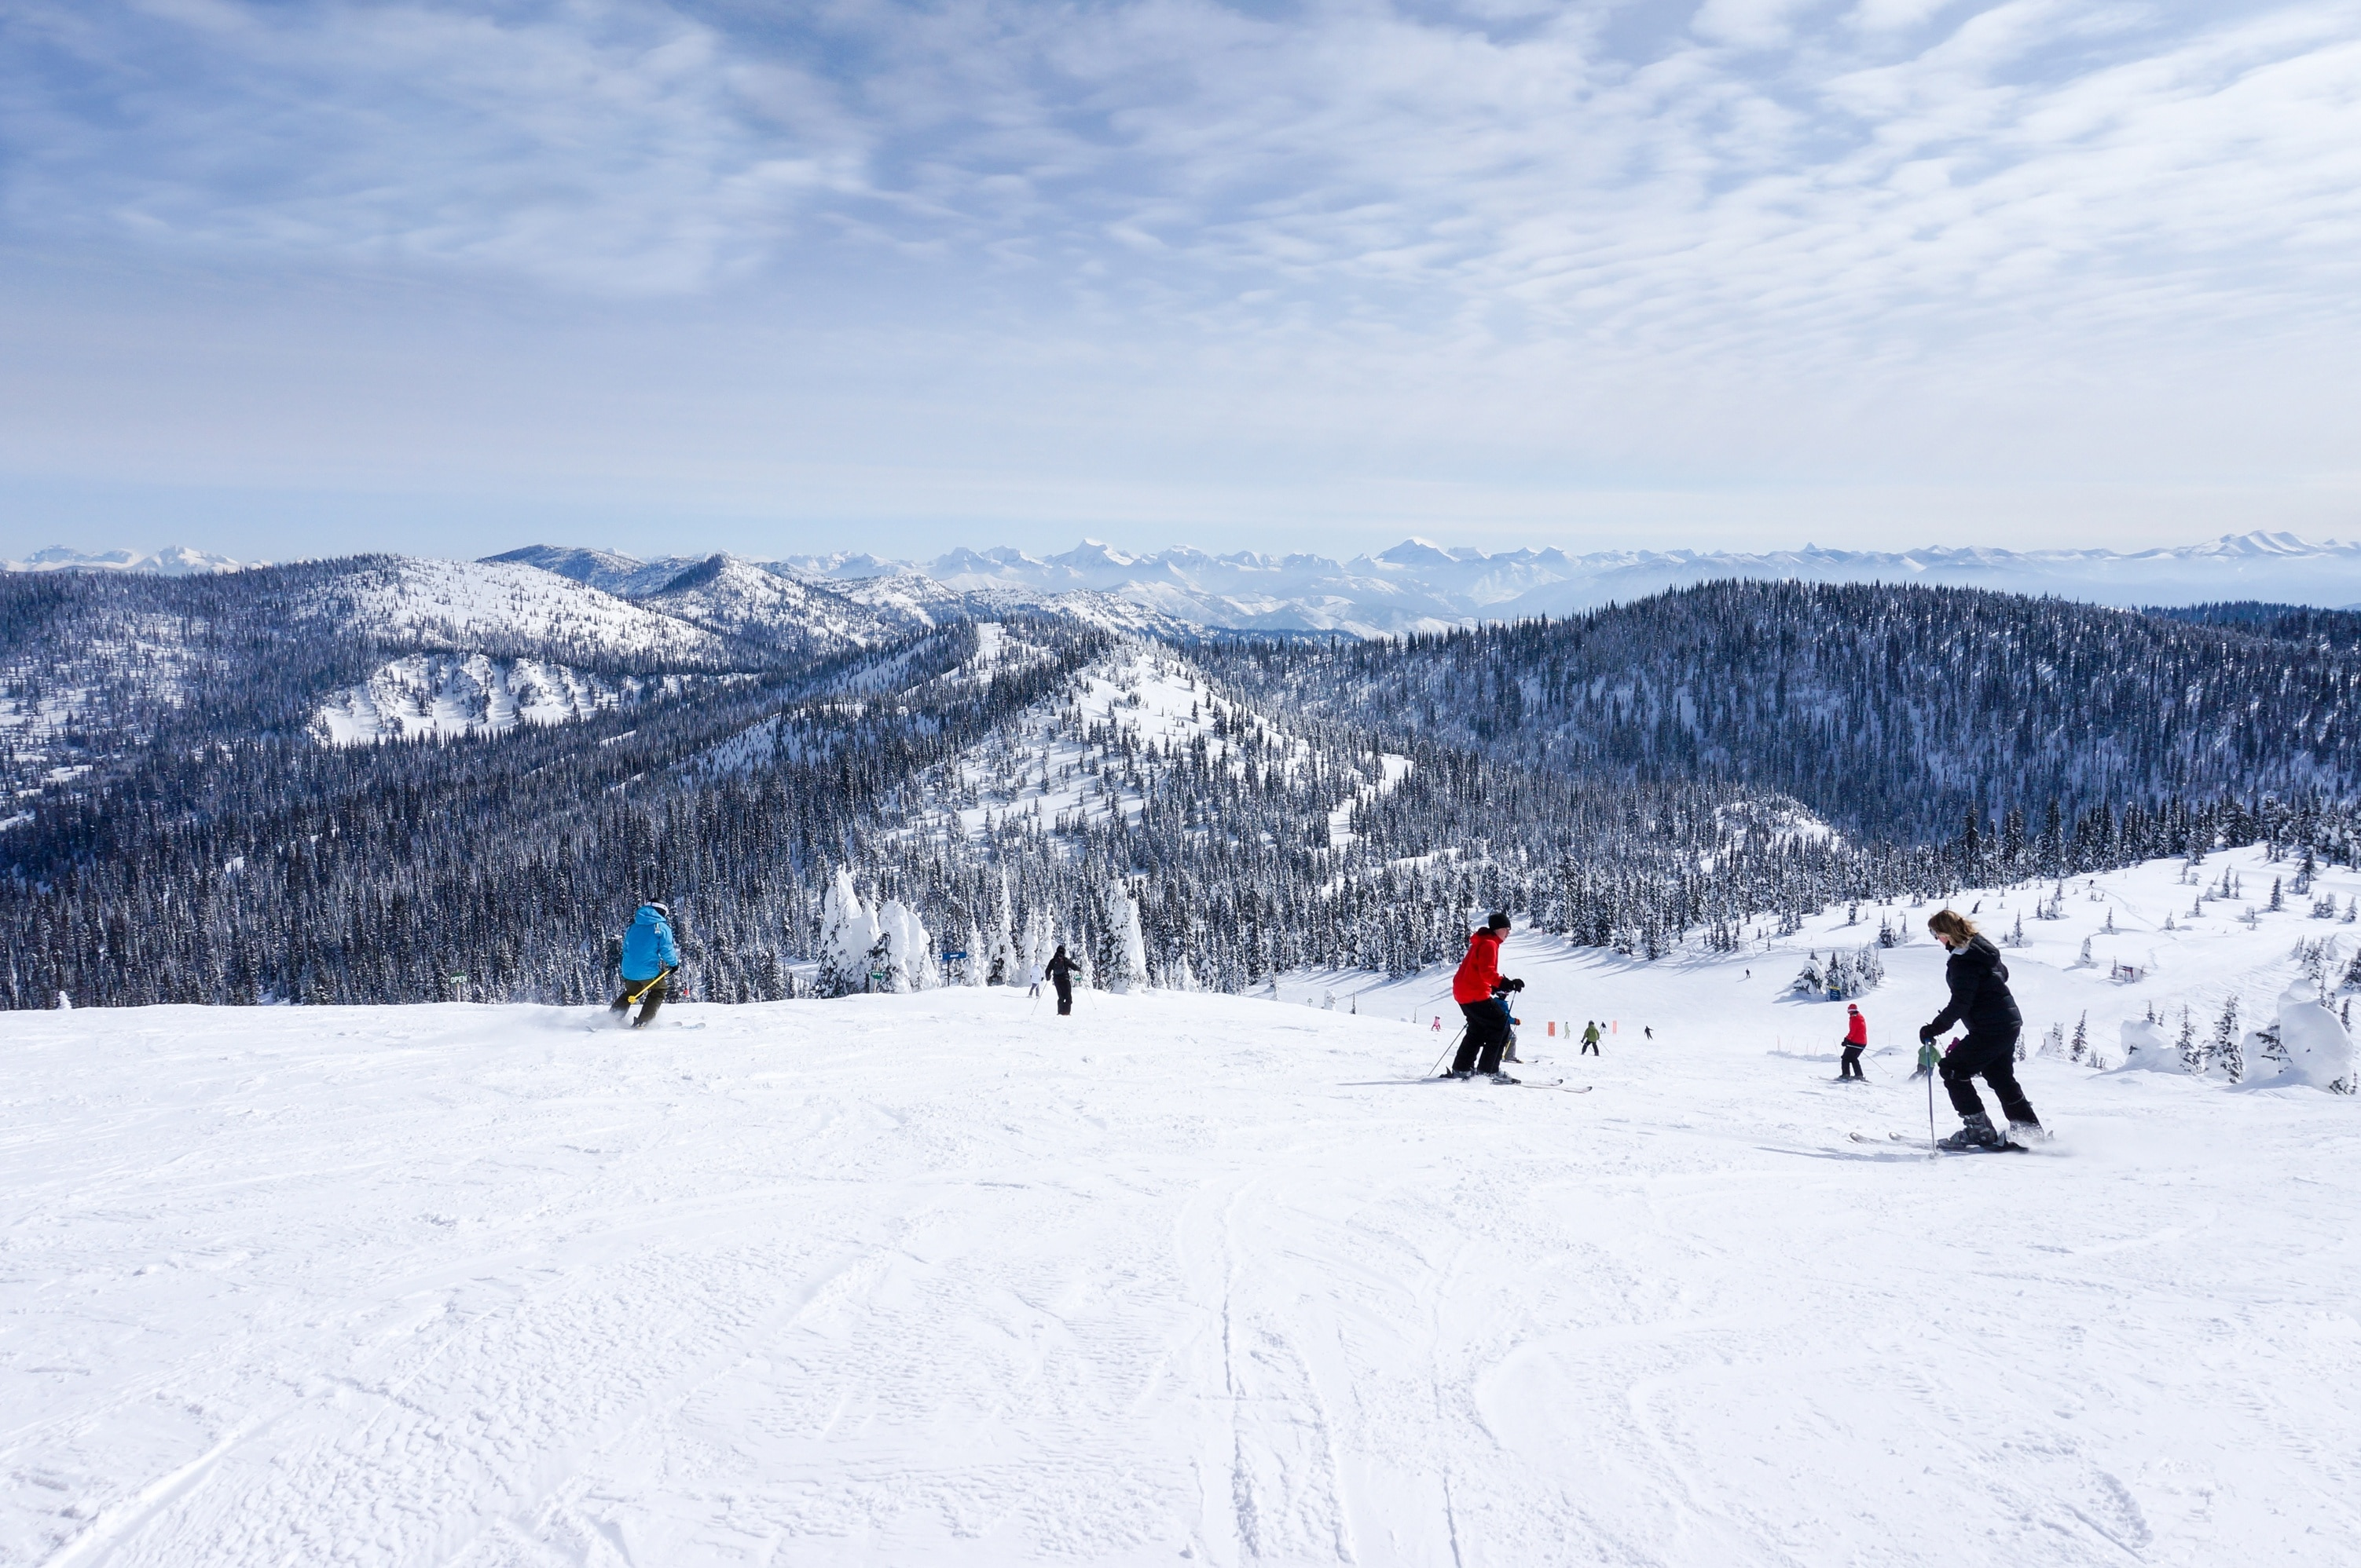
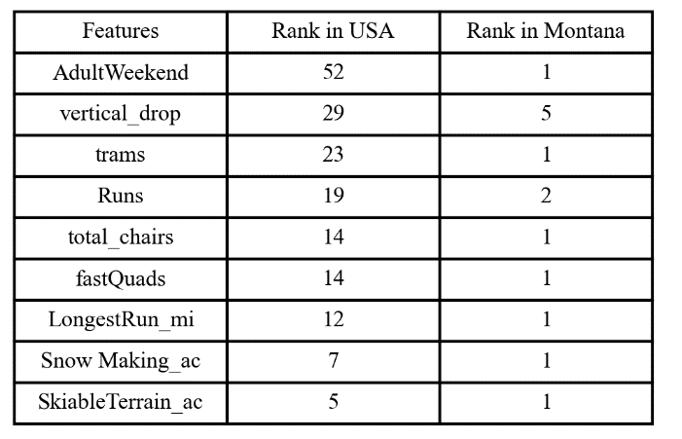
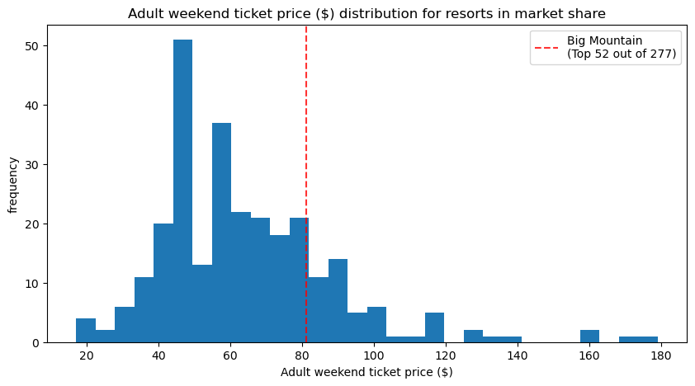
Modeling results and analysis
Big Mountain's analysis compared to other ski resorts nationally and in Montana shows strong performance, highlighted by its favorable national ranking and top position within Montana.
Increasing the adult weekend ticket price to $95.87 from the current $81.00 is recommended to align better with competitive benchmarks and significantly boost revenue by approximately $26.0 million.
Market pressure supports this price increase, but it's advisable to implement hikes incrementally to assess their impact before making further adjustments.

Slide 6
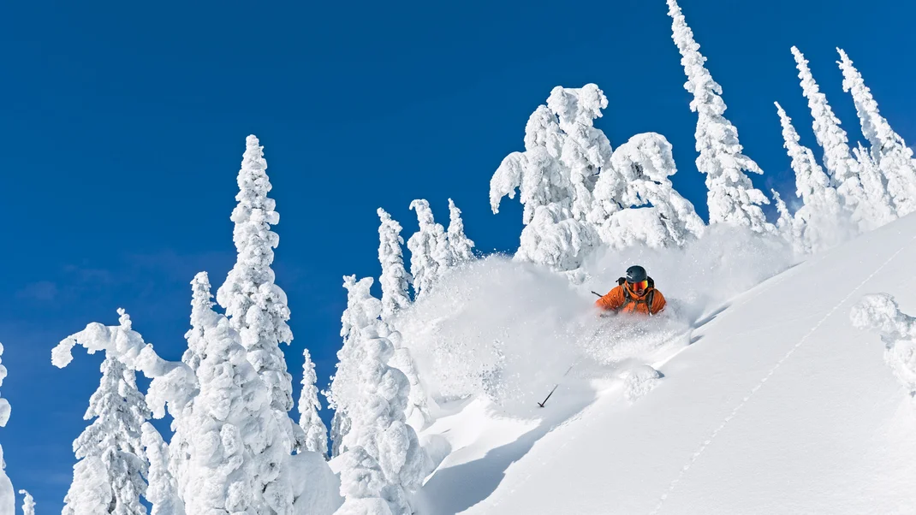
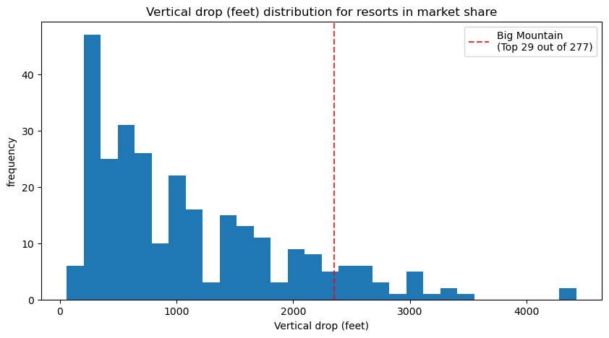
Modeling results and analysis
Big Mountain is doing well for vertical drop, but there are still quite a few resorts with a greater drop.
Increasing the vertical drop by 150 feet could support a $1.99 increase in ticket prices, potentially generating an additional $3.47 million over the season.
Implementing this change requires installing a new chairlift with an operating cost of $1.54 million for the season.
Additional operational costs for an extra run, needed for this expansion, have not been specified.

Slide 7
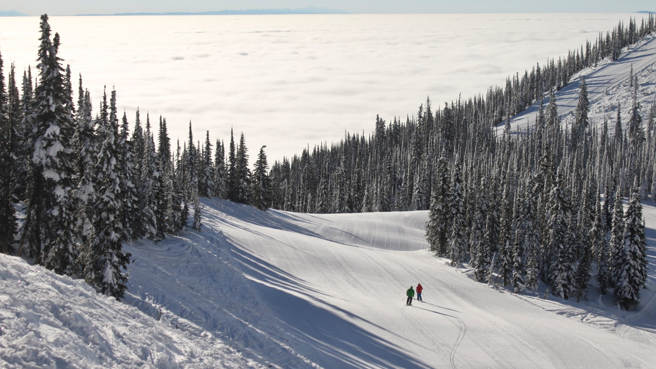
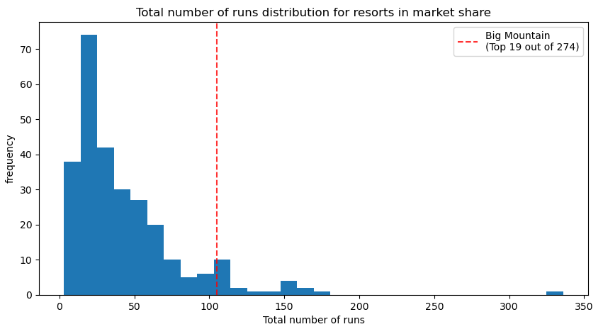
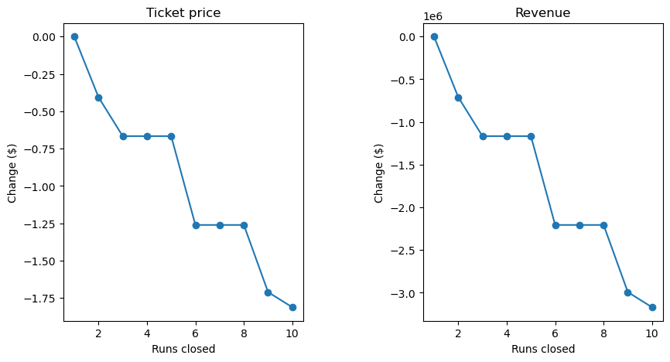
Modeling results and analysis
Big Mountain ranks second in Montana and nineteenth nationally in the number of runs, allowing for potential run reductions without losing competitive standing.
Closing one run has a negligible impact on ticket prices and revenue. Closing two or three Runs results in a noticeable decline in both ticket prices and revenue. If closing three runs, it is advisable to close four or five as there is no further decrease in ticket prices.
Closing six or more runs leads to a significant revenue reduction due to a substantial drop in ticket prices.
Recommend rotating the closure of up to five least-used runs to optimize operational efficiency without major revenue impacts.

Slide 8
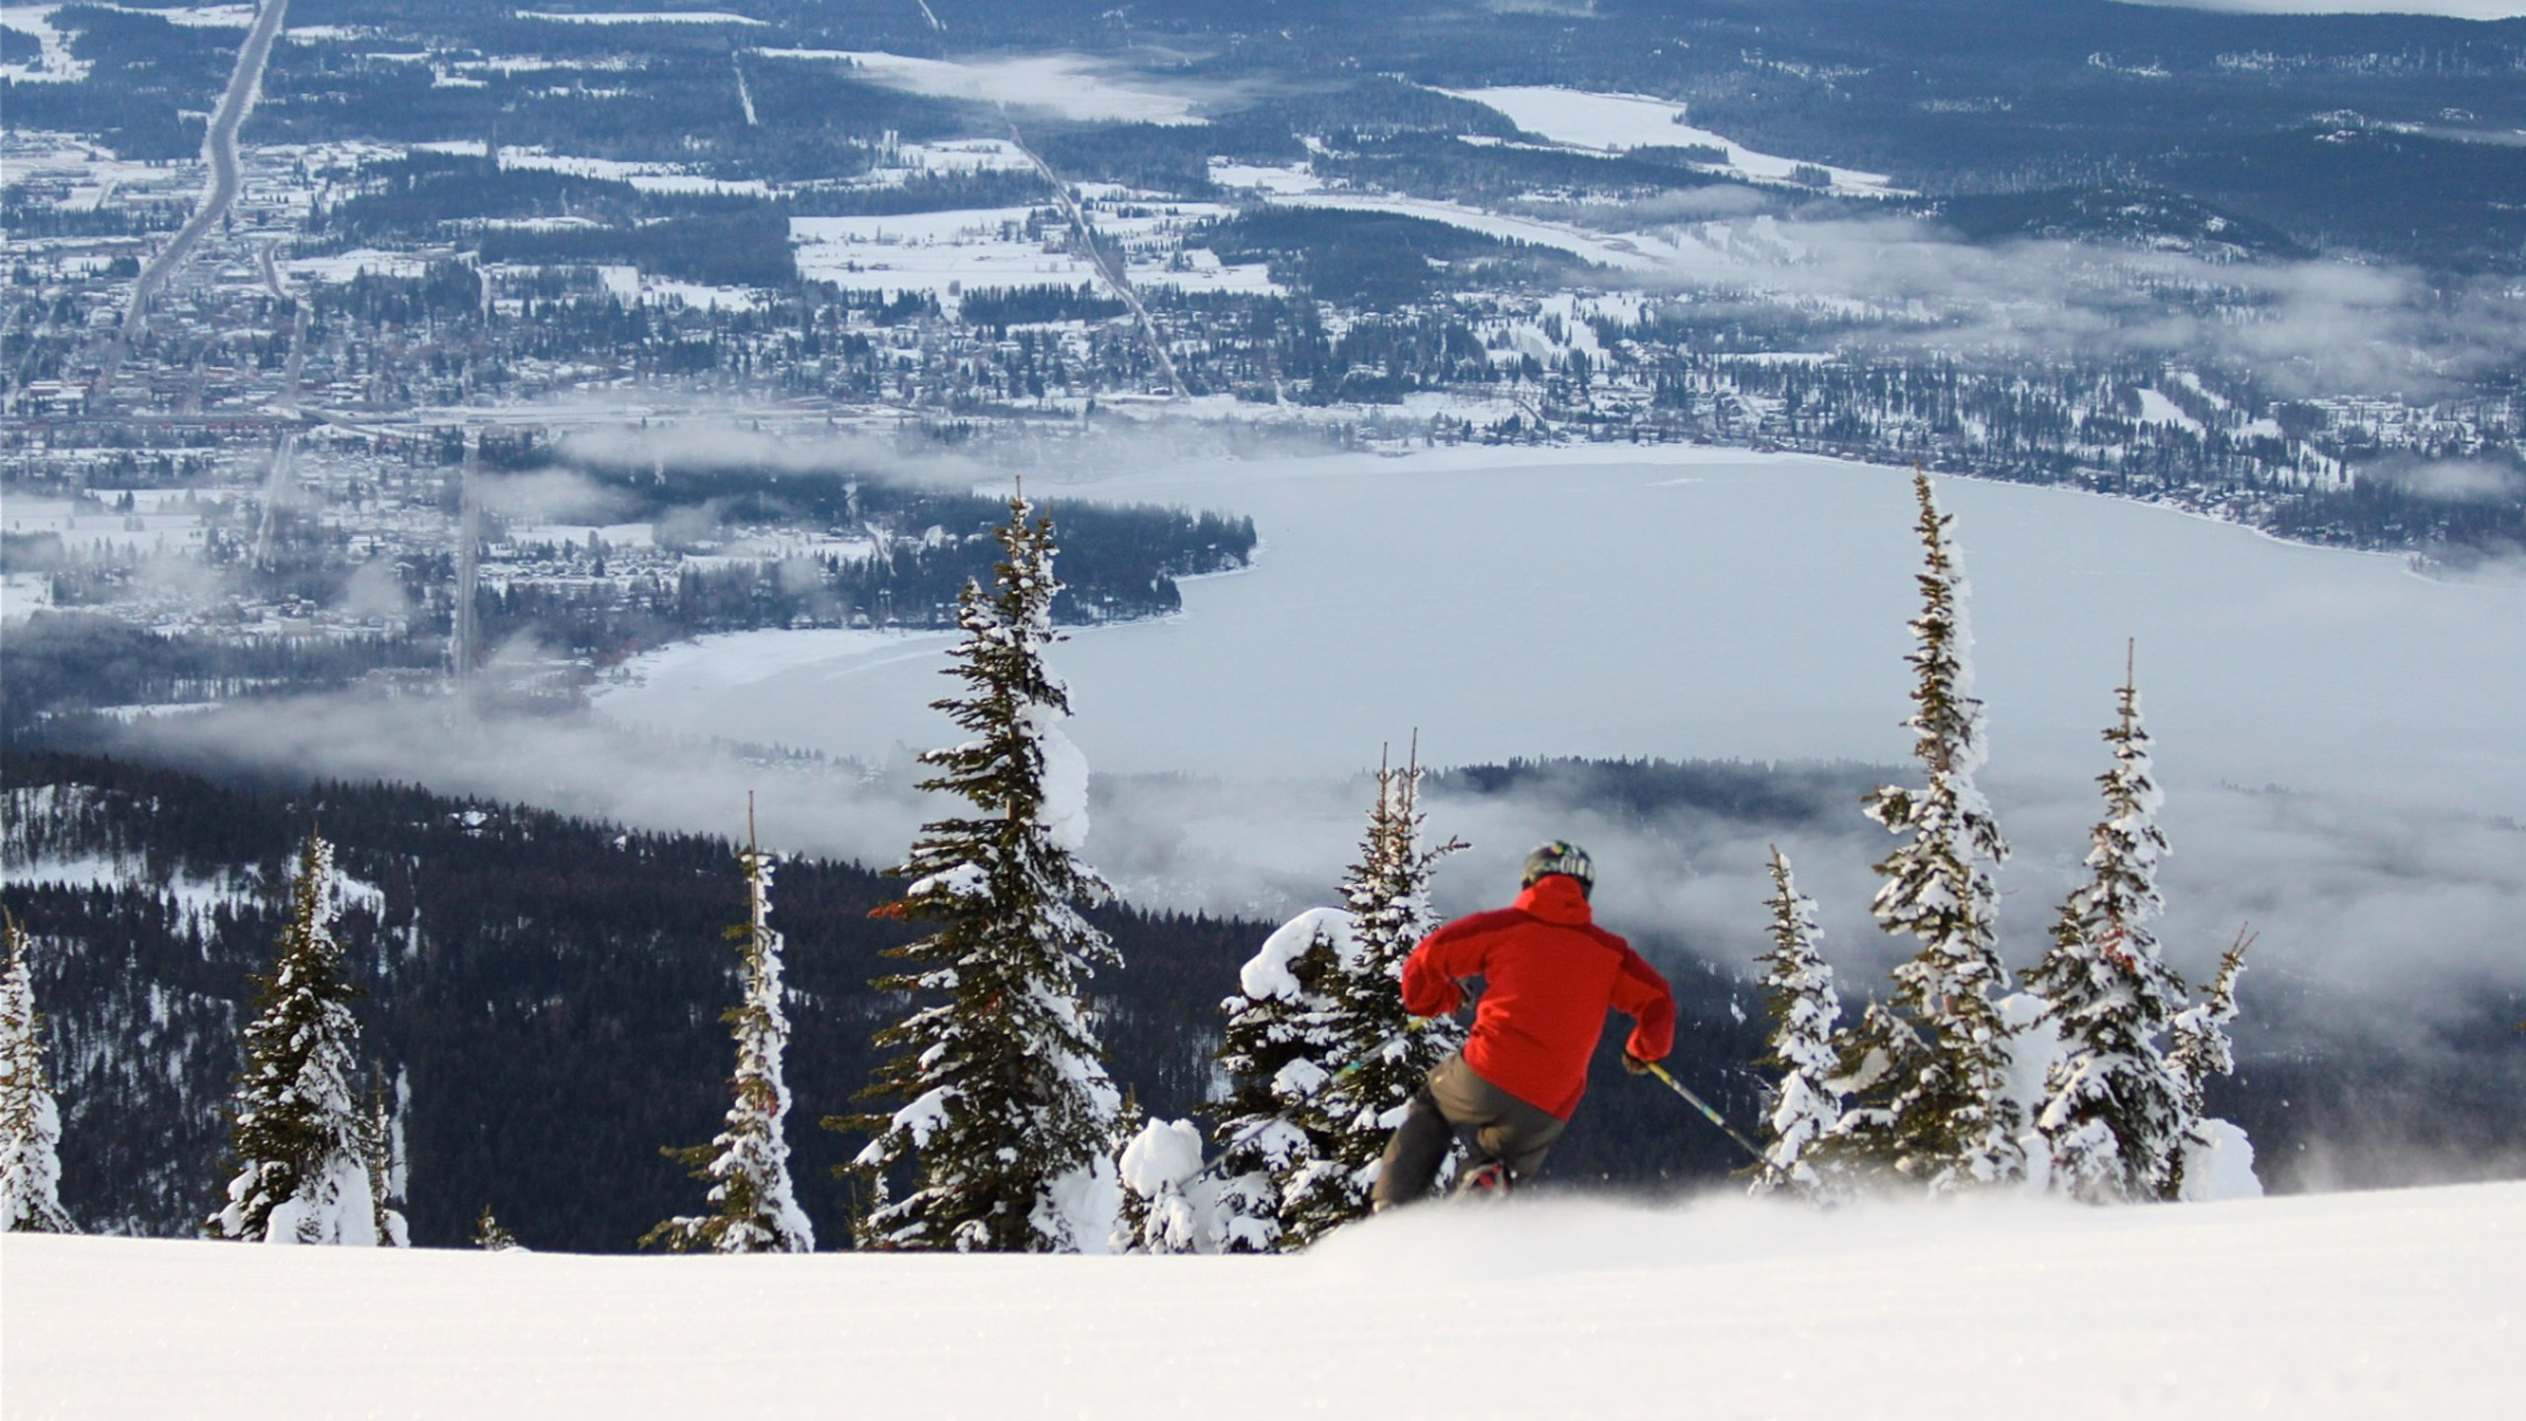
Summary and conclusion
Big Mountain Resort is a high-end resort with significant features, ranking among the top in the US and within Montana.
The current ticket price does not reflect this.A ticket price increase to $95.87 can be justified without losing market competitiveness.
Multiple pathways exist to cover the increased operational costs of the new chair lift.
Focus on the top four features identified by our model that significantly impact ticket prices: 'Runs’, 'fastQuads’, 'vertical_drop’, and 'Snow Making_ac.'

Slide 9

Thank You !
Any Questions?

